Slide 1
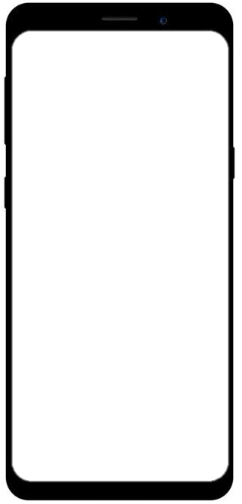
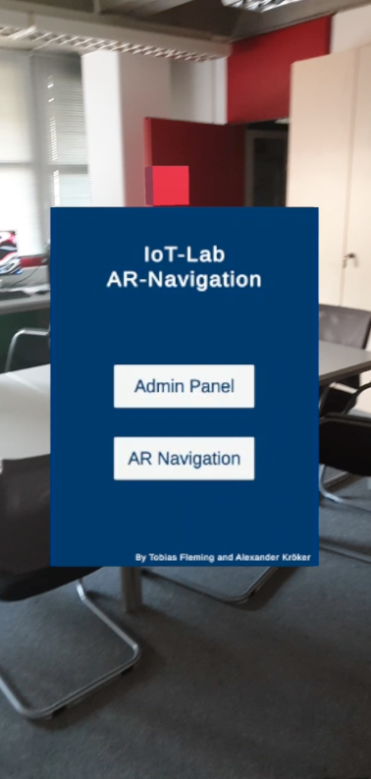
Practical Seminar / Hot Topics in Web Technologies and the Internet of Things
Developing a PWA with AR capabilties

Slide 2


Team
Tobias Fleming
6. Semester
Wirtschaftsinformatik
Alexander Kröker
6. Semester
Wirtschaftsinformatik

Slide 3


Agenda
OCR Application
Idea
Demonstration
Journey and Difficulties
Further development ideas
IoT-Lab AR Application
Idea
Demonstration
Journey and Difficulties
Further development ideas
Lessons learned

Slide 4
Everything starts with an Idea
OCR Application
Creating an App to help students getting information easier at university
Our idea:
Students can scan the name tags at every office at the university
When scanning the name relevant data gets collected from univis
User gets displayed employee information like department name, lectures and coworkers
Important for us:
Design easy to understand
App should be mobile first and work in browser
Short loading times, high performance
Reliable character recognition

Slide 5
Target agreement
OCR Application
As a user, I would like to have all personnel data in UnivIS displayed in the app based on the WiSo employee's name so I know exactly who they are.
As a user, I would like to retrieve additional chair information to the staff information so that I can better categorize the staff member. Chair information includes chair name, chair holder, other chair staff, and courses offered.
As a user, I would like to be able to retrieve a filterable list of all WiSo employees that I can use to select individual employees so I don't have to type in the full name.
As a user, I should be able to use OCR to scan the names of office nameplates to directly retrieve UnivIS information.

Slide 6
Demonstration
OCR Application

Slide 7
Journey and Difficulties
OCR Application

Slide 8
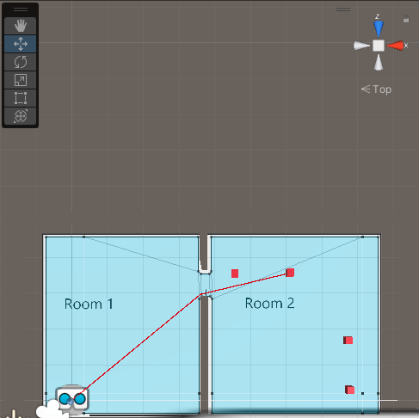
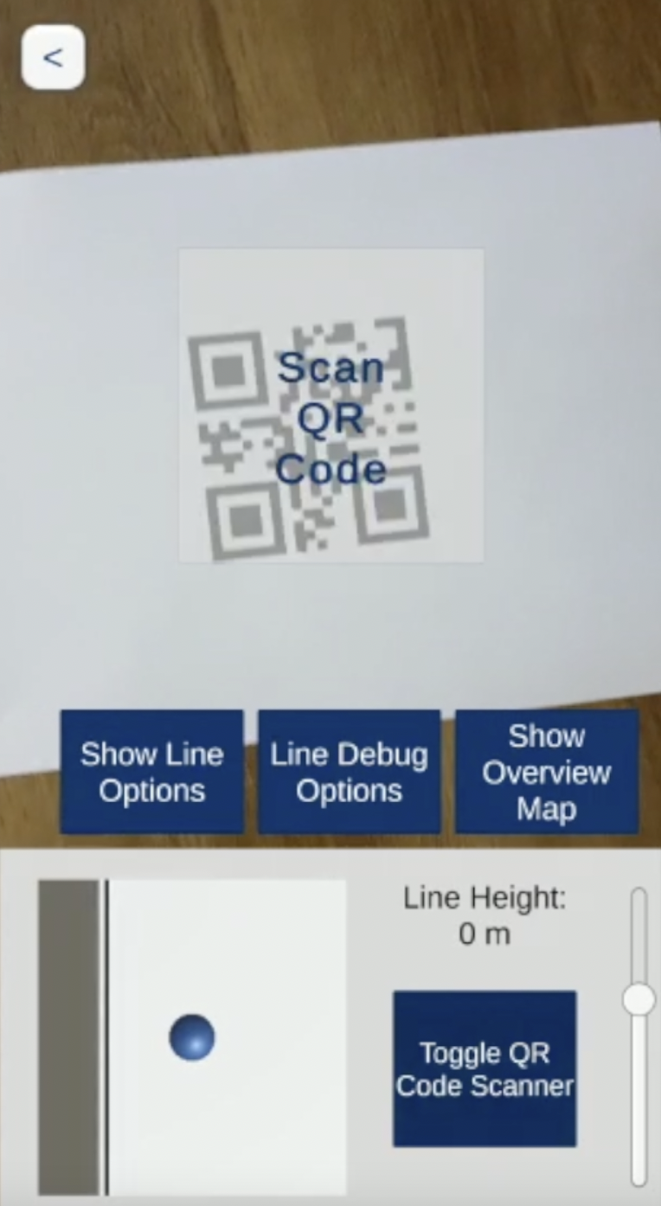
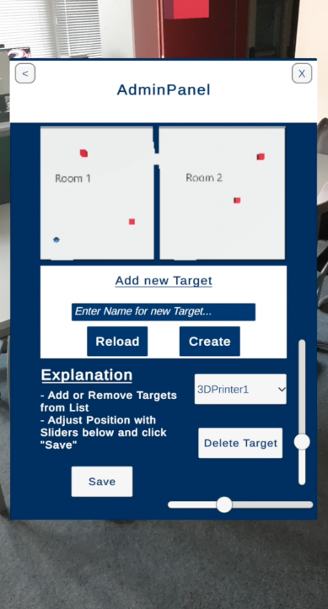
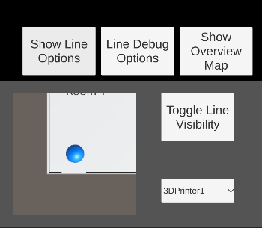
Practical Seminar / Hot Topics in Web Technologies and the Internet of Things
IoT-Lab-AR Application

Slide 9
Idea
IoT-Lab AR Application
Creating an App to help students find materials or devices in the IoT- Lab more easilty
Our idea:
Creating an application with a live navigation option towards targets
Interactive and adjustable environment
Overview over the IoT-Lab
QR Scanner to get device information live on your smartphone
Important for us:
Design easy to understand and to use
Realtime data transfer
Short loading times, high performance

Slide 10
Target agreement
IoT-Lab AR Application
As a user, I would like a list and overview map of all the major devices and areas of the IoT Lab so I can find my way around as a newbie.
As a user, I want the PWA to navigate or point me in the direction of the selected device/area using AR and using 2d map or 3d world.
As the person responsible for the lab, I would like to be able to move existing devices/areas in terms of location and description so that I can react if the structure of the lab changes.
With an QR Code Scanner I want to scan a QR Code to reset my position to the start position inside the application.

Slide 11
Journey and Difficulties
IoT-Lab AR Application
Video added before presentation because of file size

Slide 12
Journey
IoT-Lab AR Application
Libraries and frameworks
Untiy
Unity AR Foundation
Docker
NodeJS
DocFX
Short Overview
Creating the environment and Camera Management
AR Navigation
First User Interface
Saving and loading target data via JSON
Implementing QR Scanner
AdminPanel with Passwordprotection
Designing a new User Interface

Slide 13
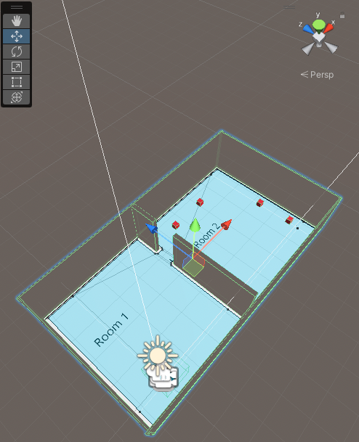
Journey
IoT-Lab AR Application
Creating the environment and Camera Management
One unit of Length in Unity is one Meter
Measure the room and recreate it in Unity
Jpg file to give the floor a texture
Navigation Mesh for navigation area
Player as a blue ball followed be a camera
Red squares for the targets
AR Navigation
Creating a Script for continously calculating the distance between two items and create a line between them
Line only shown when target selected or enabled via future button

Slide 14
Journey
IoT-Lab AR Application
First User Interface
Simple dropdown menu to select a target
Overview Map to show location in the map
Button for toggling the Line
→ Navigation functionality was working
Saving and Loading Target Data
Creating a JSON file for storing target data
Reading and Writing data to json via JsonUtility class by Unity
TargetWrapper class as an array for storing all targets in environment and to be compatible with JSOnUtility
Target class with Name and position for every target
TargetFacade class for managing the prefab of the targets

Slide 15
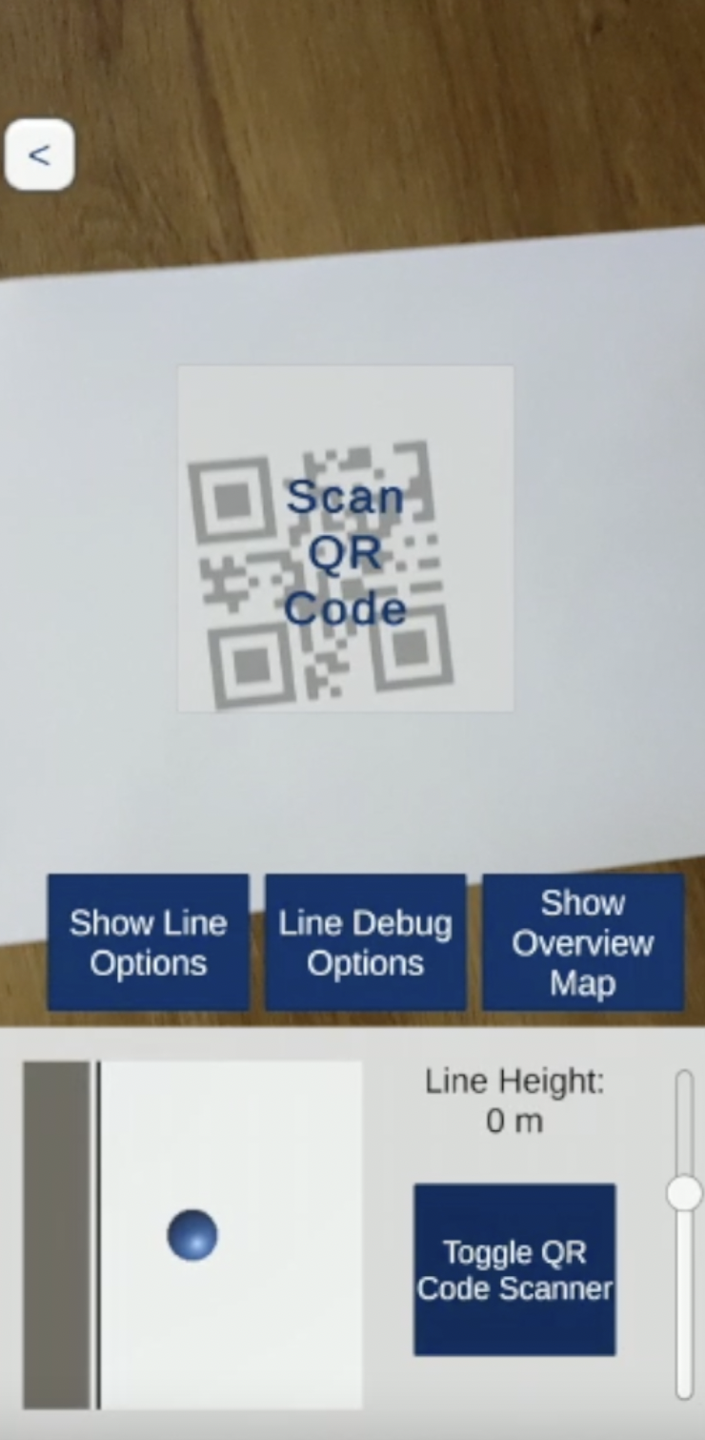
Journey
IoT-Lab AR Application
Implementing QR Scanner
Accessing the Device Camera (Article by Unity)
When the „Scan QR Code“ Panel is activated, function checks if text is recognized
When QR Code says „Start“ player gets reseted to start position element
→ QR Scanner works
Passwordprotection
Class to handle the password protection
Password saved in variable
By clicking button input gets compared

Slide 16
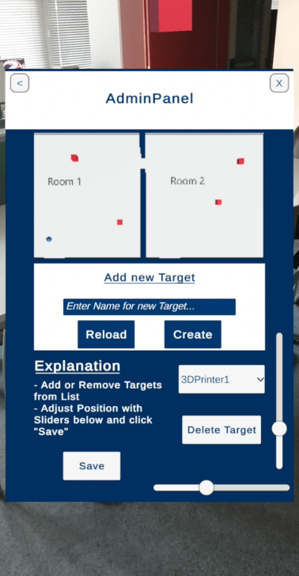
Journey
IoT-Lab AR Application
AdminPanel
Overview Map: New Camera added
Add new Target:
Function for creating new Gameobject
Adding new item to Target array
Delete Item:
Select target and click button
Delete Gameobject and target from array
Reload Button: Reload JSON data
Save Button:
JSON with current data gets created
JSON send to server
Two Sliders
Select Item in dropdown menu
Sliders get current position data when item selected
When slider adjusted item position changes in environment

Slide 17
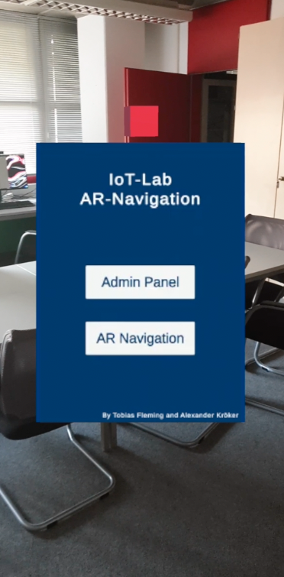
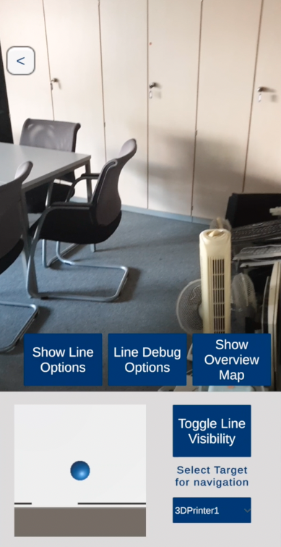
Journey
IoT-Lab AR Application
Designing new Interface

Slide 18
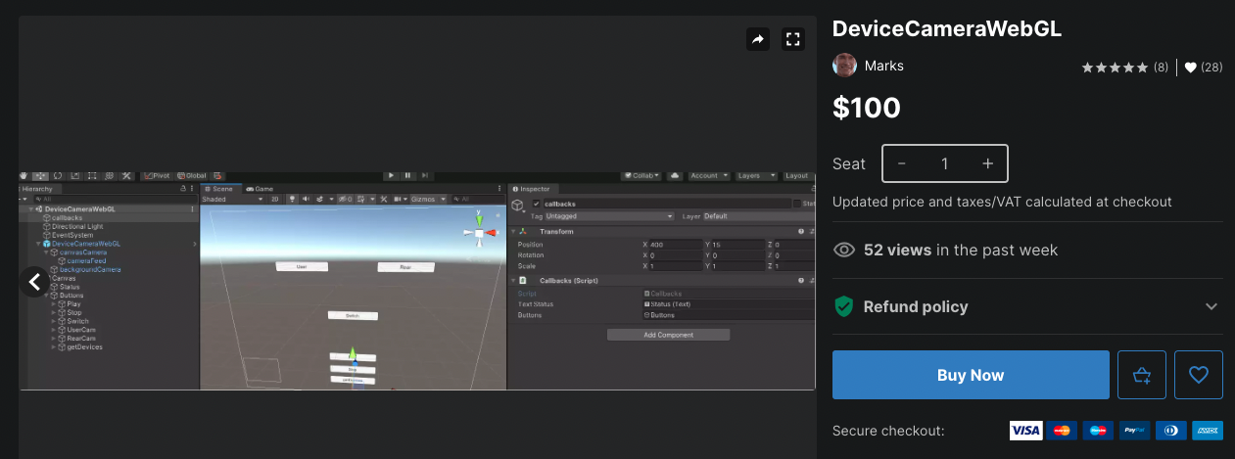
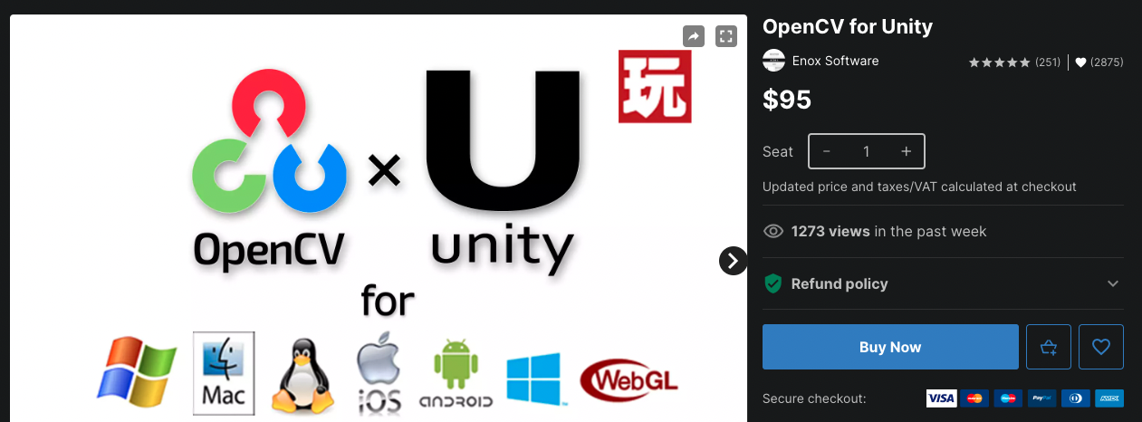
Difficulties during development
IoT-Lab AR Application
Unity documentation hard for beginners
Build In WebGl publishing
Not possible due to AR Foundation incompatibility
Possible solutions with Unity extensions:
OpenCV for Unity: price 95 dollars
DeviceCameraWebGl: price 100 dollars
ARWT: Only for smaller games, uncomplete documentation

Slide 19
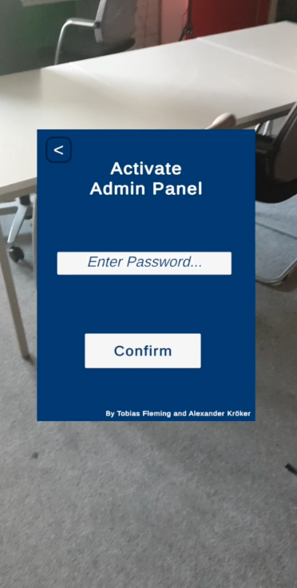
Further development ideas
IoT-Lab AR Application
Improve room recognition
Panel for changing the password
Possibility to scan operating instructions as QR code through the QR scanner to get direct help with questions
Targets get their own icons or avatars
Possibility to change the height of the targets when they are selected or added

Slide 20

Learnings for our next project
IoT-Lab AR Application
What would we do better next time?
Research is everything
Bug fixing and code documentation takes lots of time
Check all compatabilites before starting to code
Check all possible ways to create the solution (AR.js vs Unity)
What would we keep?
Weekly Update meetings
4+ hours team coding
Github for code sharing
Shared Discord channels

Slide 21
Sources:
Images:
https://play.google.com/store/apps/details?id=com.samsung.Samsung_HA_AR&hl=de&gl=US
https://www.flaticon.com/de/kostenloses-icon/ocr_5200010
https://buildfire.com/become-mobile-app-developer/

Slide 22
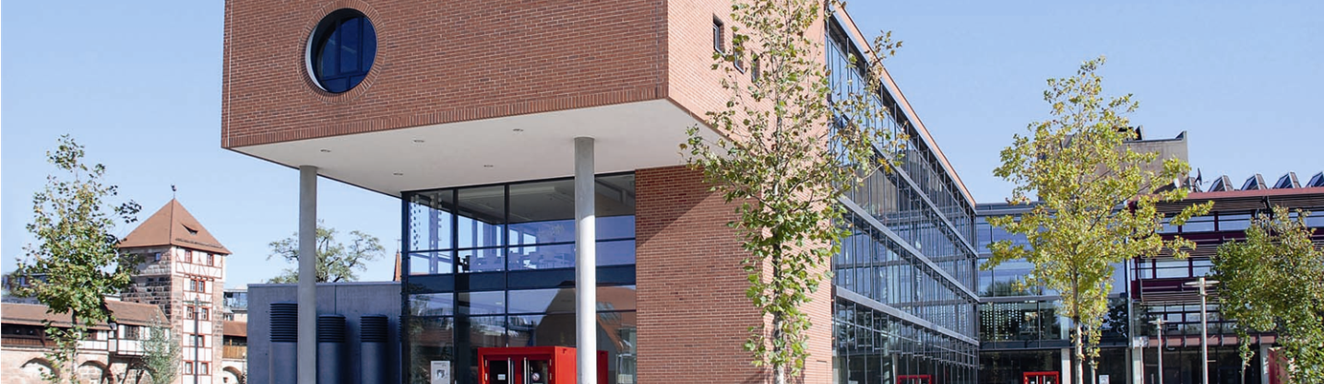
Thank you for your attention!

